Slide 1
AR simulation of Schizophrenia
A simulation for evoking empathy and promoting awareness
Abhinuv Nitin Pitale
Adithya Upadhya
Hamza Manzoor
Naresh Nagabushan
Supervised by,
Dr. Doug A. Bowman
Dr. James Ivory

Slide 2
What is Schizophrenia?
A mental disorder characterized by abnormal social behavior and failure to understand reality.
Notes:
A disorder that affects a person's ability to think, feel, and behave clearly.

Slide 3
Symptoms
Behavioral
Cognitive
Mood
Psychological
Speech
Social isolation
Disorganized behavior
Aggression
Memory loss
Mental confusion
Slowness in activity
Anxiety
Apathy
Feeling detached from self
Hallucination
Paranoia
Hearing voices
Circumstantial speech
Incoherent speech

Slide 4
The problem
Problem
Reason
Proposed Solution
Schizophrenic patients are sometimes shunned by the society.
Not enough awareness about this illness among the general population
Simulate the experience of Schizophrenia to evoke empathy.

Slide 5
Research Questions
RQ1: How accurate is AR simulation in inducing visual and auditory hallucinations?
RQ2: Would a Schizophrenia AR Simulation be an effective technology in evoking empathy and generating awareness regarding the ailment?
RQ3: Can subjects concentrate on the task at hand with different hallucinations?

Slide 6
Challenges

Slide 7
AR vs. VR?
AR:
Unlimited contexts
Hallucinations on real world
VR:
Consistent experience
Greater control in the environment setup
Notes:
Mention this as a challenge as well.

Slide 8
Markers in Augmented Reality
What are they used for?
Kinds of Markers?
Integrating them seamlessly into the environment.

Slide 9
Integrating Markers into Our World
The markers that were readily available were weird and obvious.
They had to be ‘directed’ into the scene in an intuitive and non obvious manner
Included everyday objects as targets
Hid the markers in the scene until they had to be shown to the subject

Slide 10
Time for a Live Demo!

Slide 11
Implementation

Slide 13
The Experimental Setup
The participants undergo an interview which involves simple Q&A which is augmented with visual and auditory hallucinations
Sales Manager Interview

Slide 14
Walkthrough
Pre-Interview Ques.
Interview
Post Interview Ques.
Knowledge of Schizophrenia.
Empathy towards patients with this ailment.
Simple Questions.
Inferring from Graphs.
Introduce Product.
Collect Forms.
Similar Questions.
Objectively study the change in attitude.
Effectiveness of the simulation.

Slide 15
Visual & Auditory Hallucinations
Discouraging Voices
Visual artifacts that distracted / scared the participant

Slide 16
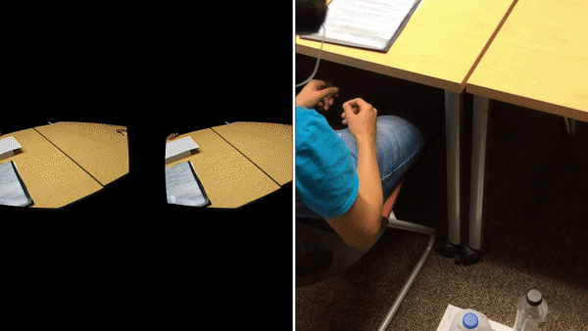
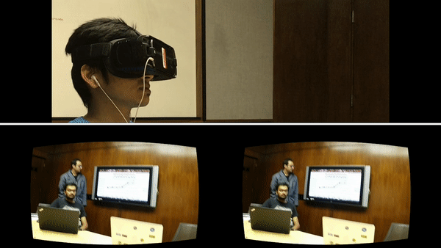
Scene Direction
AR content embedded in the scene.
AR content was introduced and removed as a part of the interview

Slide 17
Is AR effective?
RQ1: How accurate is AR simulation in inducing visual and auditory hallucinations?
Probably yes!

Slide 18
User Study
Analysis and visualization of survey data from 10 participants

Slide 19
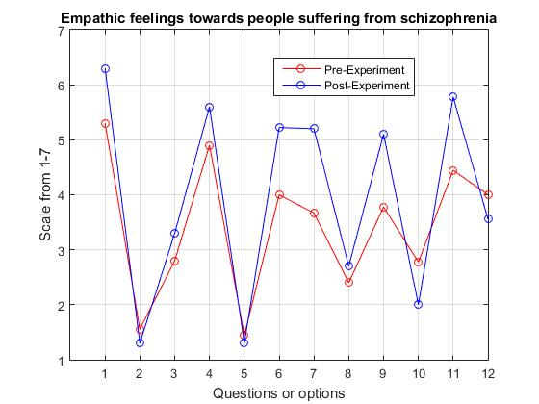
Section 1: Empathic feelings towards people suffering from schizophrenia
X-Axis data points
Sympathetic
Disgusted
Scared
Compassionate
Angry
Soft-hearted
Warm
Afraid
Tender
Confused
Moved
Anxious
1. Not at All 7. Extremely

Slide 20
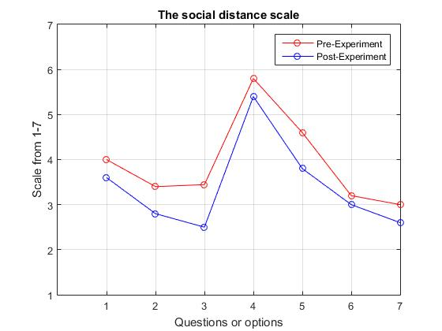
Section 2: The social distance scale
X-Axis data points
Renting a room
Schizophrenic individual as a coworker
Schizophrenic individual as your neighbor
Caretaker of your children for a couple of hours
Children marry someone suffering from Schizophrenia
Introducing a schizophrenic individual to your friend
Job Recommendation
1. Definitely willing 7. Definitely Unwilling

Slide 21
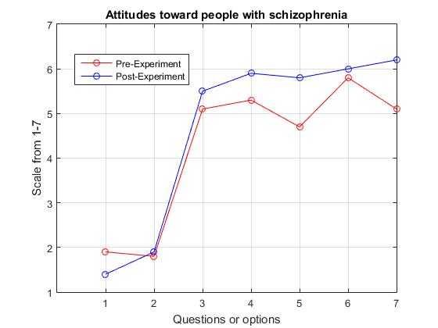
Section 3: Attitudes toward people with schizophrenia
X-Axis data points
Their own Fault
They could have avoided contracting the disease
Care about the plight of people with schizophrenia?
Insufficient help from society
Importance of helping people with schizophrenia
More could be done from society to help them
General feelings towards schizophrenic individuals
1. Strongly Disagree 7. Strongly Agree

Slide 22
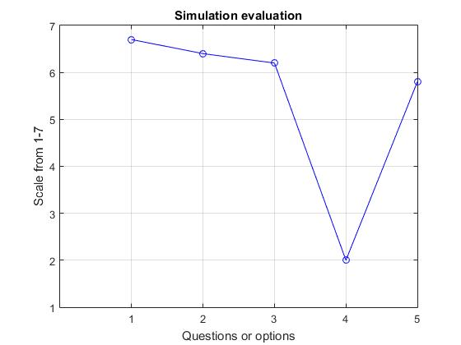
Section 4: Simulation Evaluation
X-Axis data points
Simulation was interesting
The simulation was educational
Simulation promotes awareness
Simulation shouldn’t be administered to people with schizophrenic colleagues
Simulation makes people more sympathetic towards schizophrenic patients
1. Strongly Disagree 7. Strongly Agree

Slide 23
Effectiveness
RQ2: Would a Schizophrenia AR Simulation be an effective technology in evoking empathy and generating awareness?
As per our user study, yes!

Slide 24
Concentration
RQ3: Can subjects concentrate on the task at hand with different hallucinations?
Subjects were distracted and could not focus on interview due to the visual and the auditory hallucinations.

Slide 25
References
Penn, David L., James D. Ivory, and Abigail Judge. "The virtual doppelganger: Effects of a virtual reality simulator on perceptions of schizophrenia." The Journal of nervous and mental disease 198.6 (2010): 437-443.
“Auditory Hallucination Simulation.” YouTube, YouTube, 27 Apr. 2015, www.youtube.com/watch?v=nsWm4cAGTZU.

Slide 26
Thank You!

Slide 27
Scene Direction
AR content embedded in the scene

Slide 29
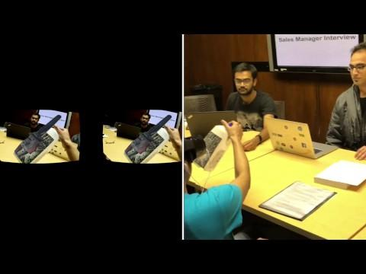
Scene Direction
Distracted from task at hand
Slower responses

