Slide 1
PathFinder
Navigation for Cyclists
Abhinuv Nitin Pitale
Abhishek Ajey Bendre
Naresh Nagabushan
Advised by,
Prof. Dr. Tom Martin
Notes:
Out project was designing a wearable for non automotive systems
We chose the problem of navigation for cyclists.

Slide 2
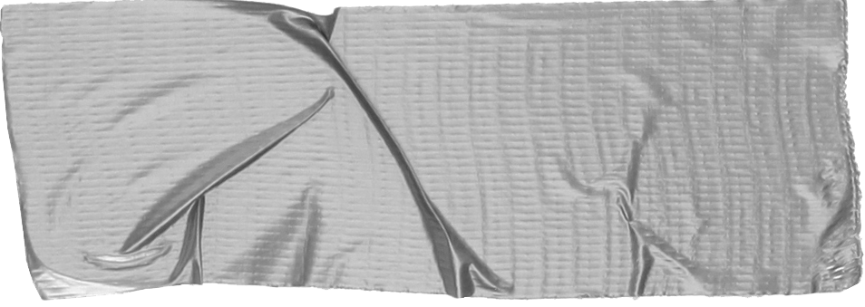
What? Why? How?
Navigation assistance for cyclists
Turn by Turn Navigation Uses MapBox API to provide directions and distances to your destination
Cheap Less than 50$
Simple Just shows you the next turn at a glance. No complicated interface.
Notes:
The product designed provides turn by turn assistance to the rider
The novelty we were targeting were cheap and simple
Target market was non professional cyclists

Slide 3
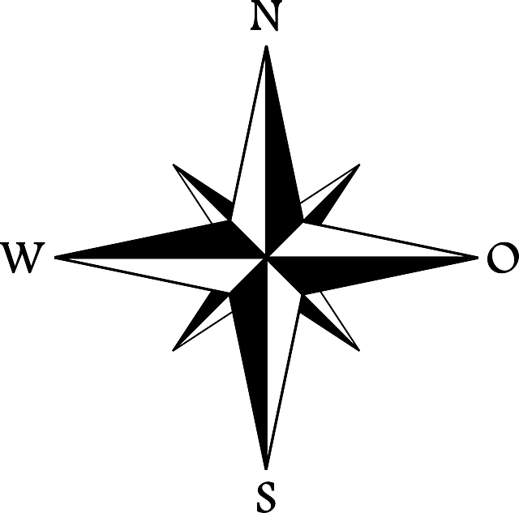
The Problem
Navigation for Cyclists
Mounting a Phone - Risky/Not Stable
Garmin Navigation Devices- Expensive for non-professional use
Requirements?
Intuitive and Easy Interface
Weather-Proof
Inexpensive
Notes:
Some existing solutions were hooking up your phone with google maps on it
The other option was buying a Garmin or a Absolute
But these options are pretty expensive, mostly not feasible for non professional cyclists.
Hence the requirements we narrowed down on were these
The natural answer to this was a comoass

Slide 4
Hardware
CONSTRAINTS | SOLUTIONS
Embedded Platform Small Low Power Wireless Comm | Feather 32u4 (with BLE)
Interface Intuitive Bright Direction and Distance encoding | Neopixel Ring with RGB LEDs
Control Easy to use No extra device | Android Application - with Mapbox API
Constraints and Solutions
Notes:
Constraints we had were solved as follows
The embedded platform had to be small, light and needed bluetooth -> Adafruit Feather
The Interface had to be bright, intuitive and encode distance and direction easily -> Neopixel Ring
The control is via an Android app

Slide 5
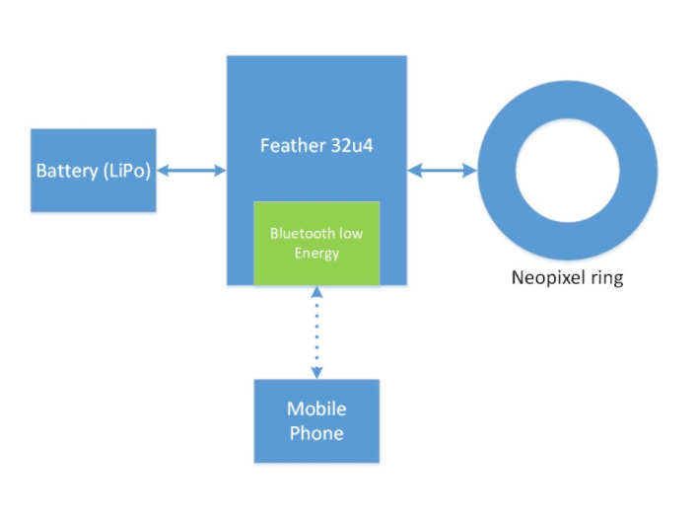
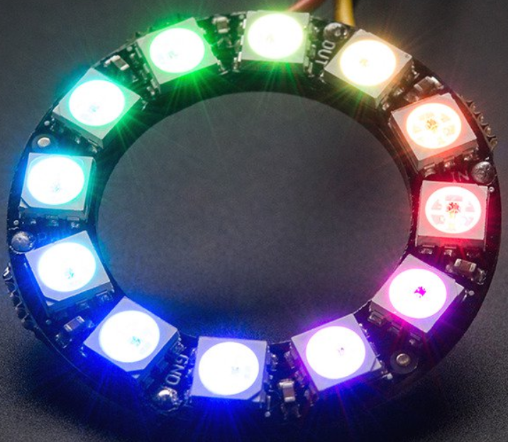
System Block Diagram
Notes:
Dont spend too much time on this slide

Slide 6
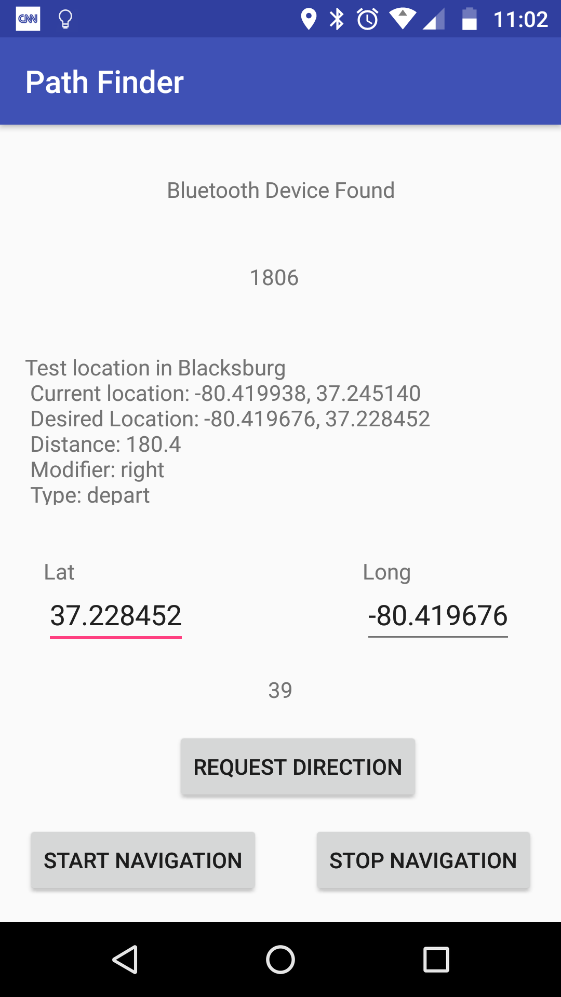
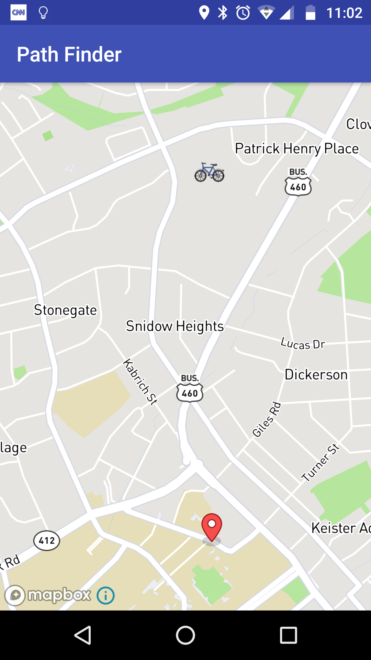
The Prototype
The Application
Notes:
Enter the lat and long of the location to go to.
The interesting part is that this can be hardcoded and hence b used in a historic trail scenario.
The API provides
-distance , next turn
-We also sent a bit which helped determine the brightness

Slide 7
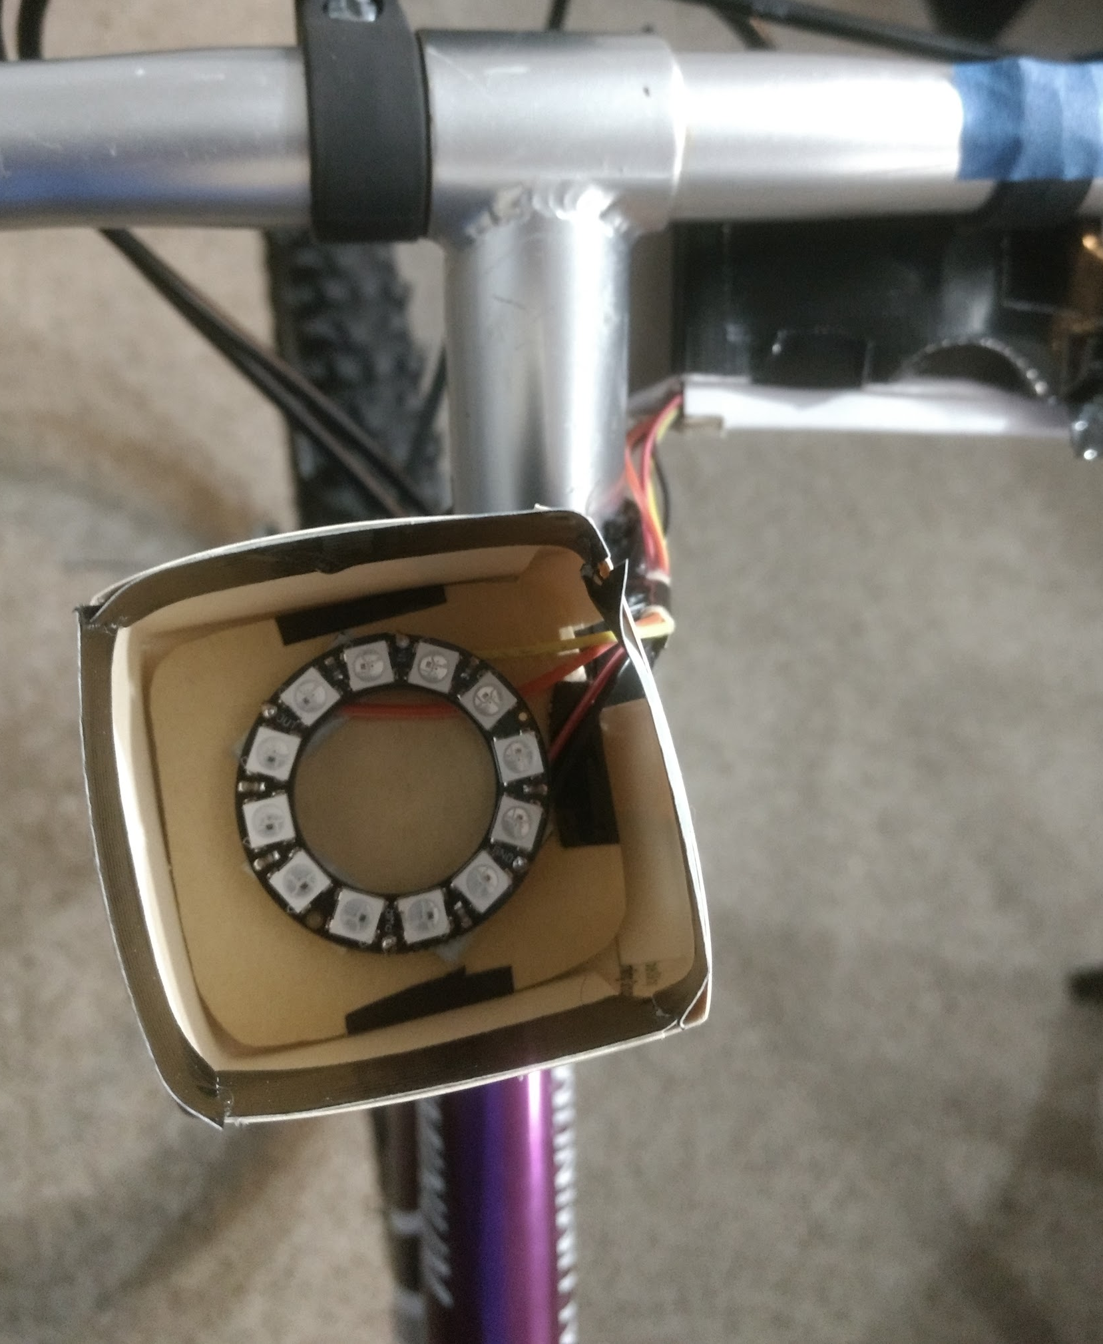
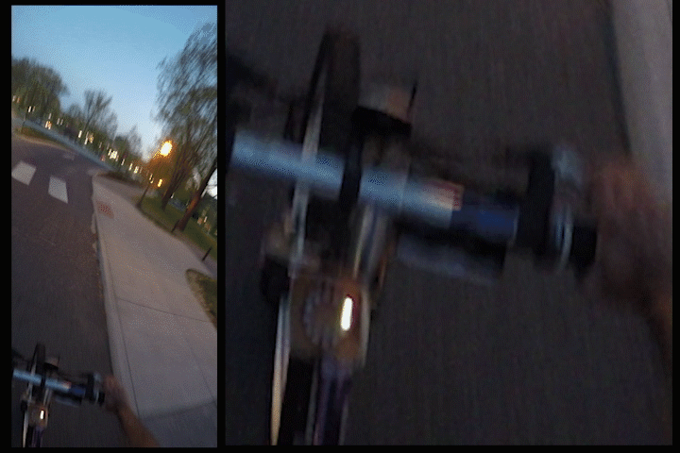
The Prototype
The Device
Notes:
This is how it looks as of now
The pattern was decided based on a short user survey.
Features describe here.
Shows direction
Encodes Distance
Brightness adaptive to daylight

Slide 8
Conclusions
Advantages / Features -
Small, Portable and Low Cost
Intuitive display - Direction + Distance
Simple Android Application
Adaptive Brightness (Day/Night)
Ideal for Non Professional Bikers, MetroBikes and Guided Touring
To be Continued
User Study
App Fixes
3D printed custom mounts
Explore Distance Encoding
Weather Proof

Slide 11
Design Decisions
Week 1-3
Week 5-6
Week 7-9
Week 4
Week 7-8
Week 9-
Finalizing the problem statement
Soldering, Interfacing Testing the Ring
Mounting Prototyping Hardware - Software Integration
Finding Path ...
User Study for encoding direction and distance Test Map APIs
Integration

